Slide 1
Leveraging GenAI for Biometric Voice Print Authentication
Lani Lewis, Erica Brooks, Lijo Jacob
Advisors: Faizan Javed, Gaurav Mittal, Shivam Negi SMU Capstone Spring 2025

Slide 2
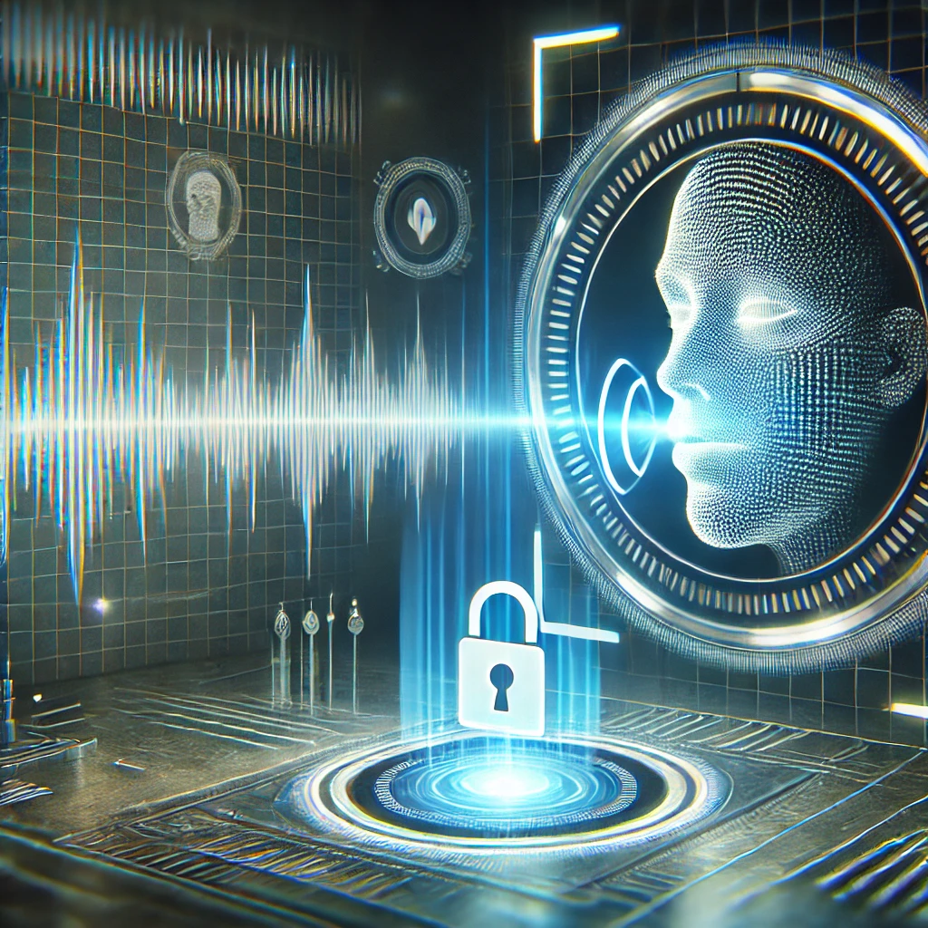
Why
Notes:
1min

Slide 3
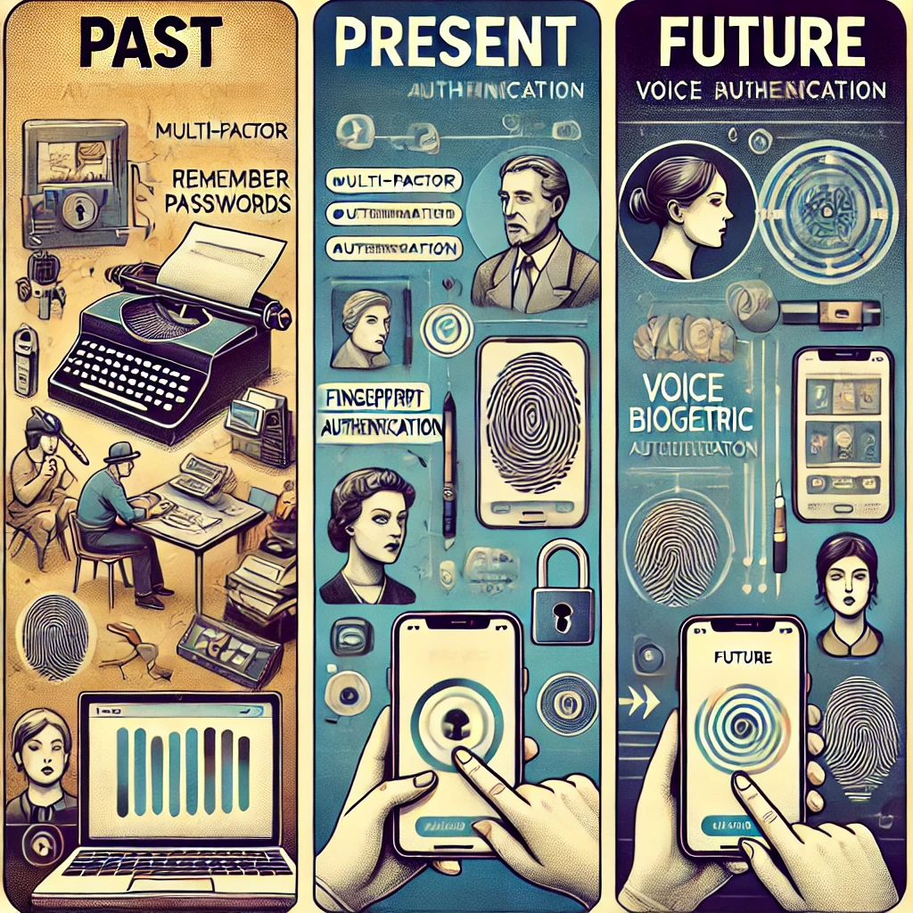
Past & Future

Slide 4
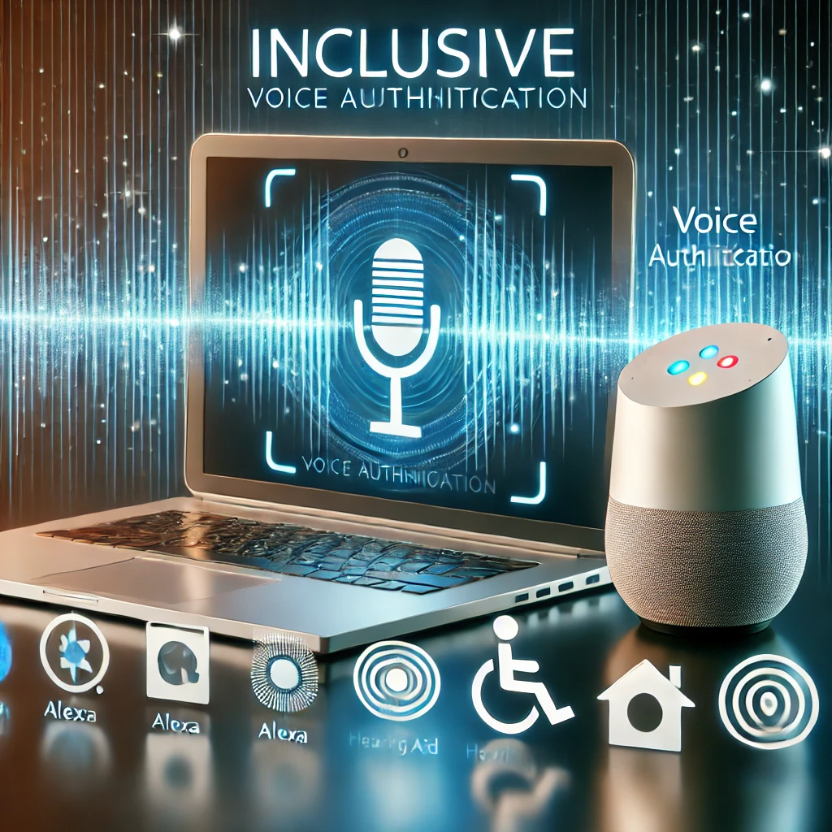
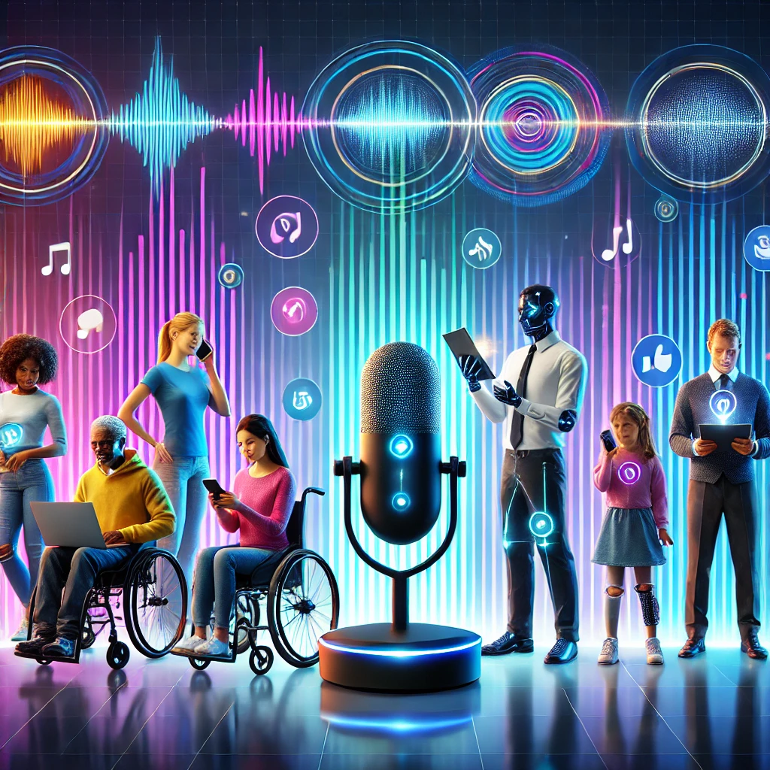
Inclusive | Personalized

Slide 5
How
Notes:
7mins total

Slide 6
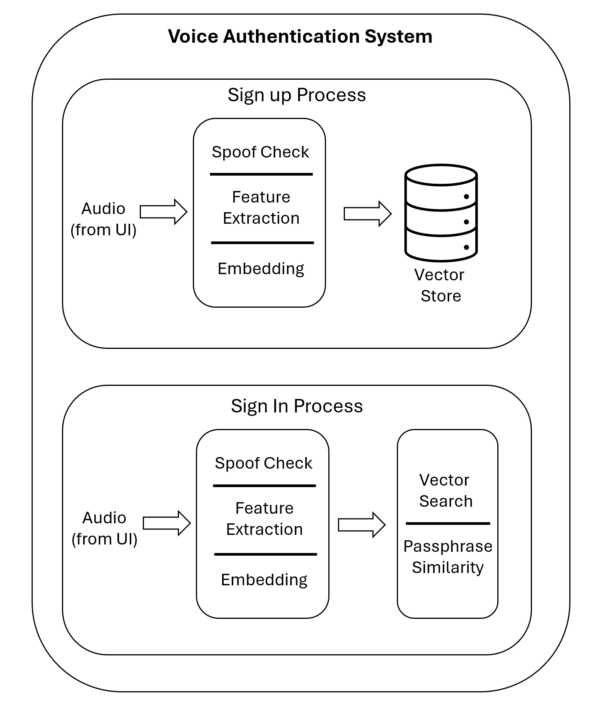
High Level Overview
Notes:
2min

Slide 7
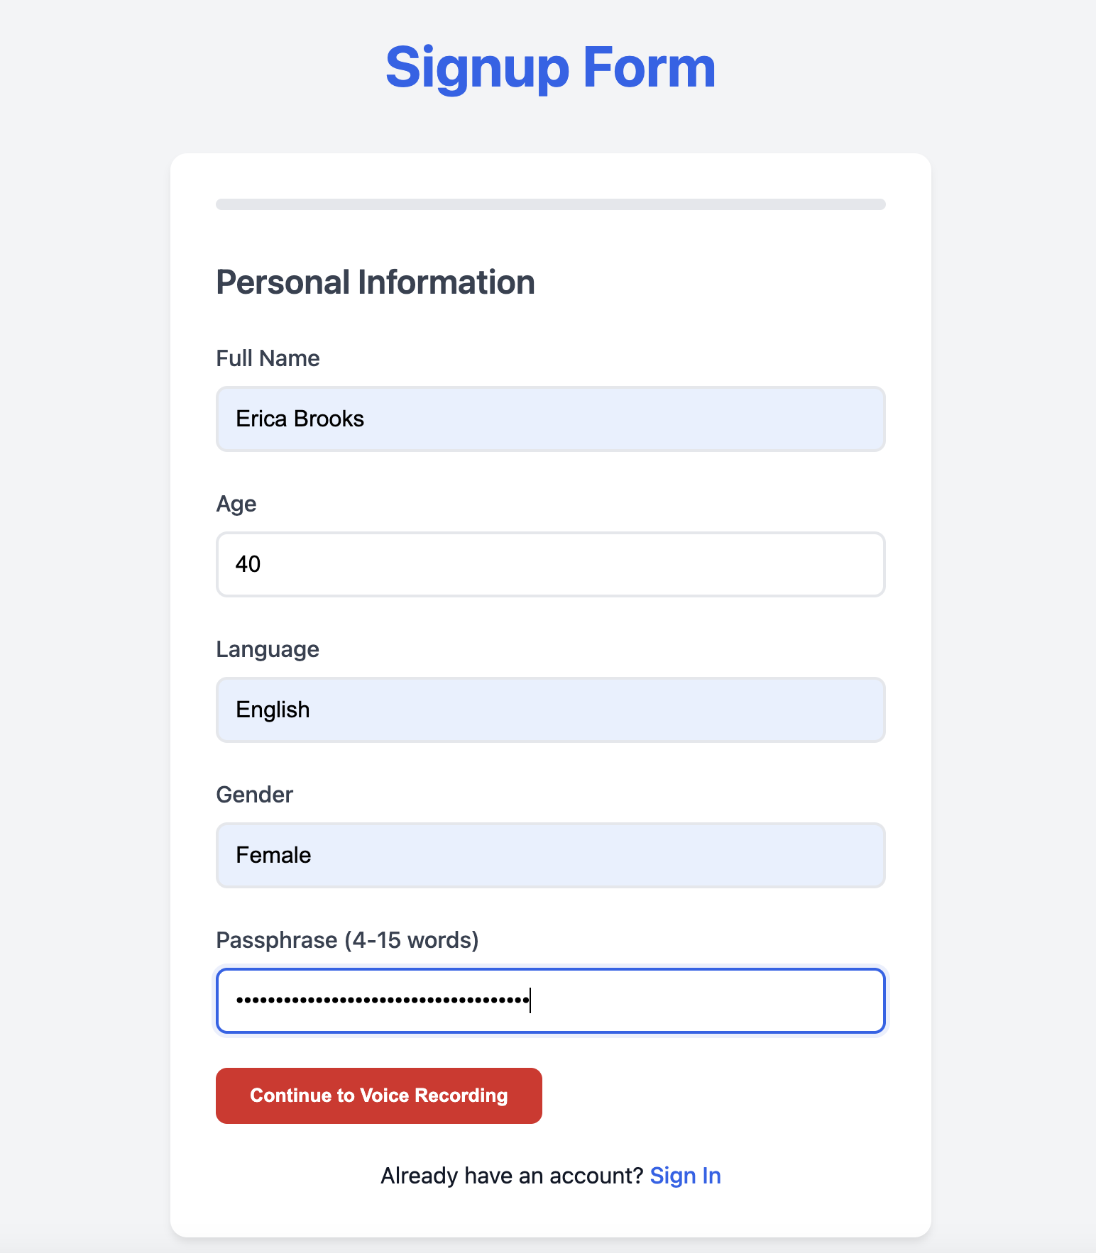
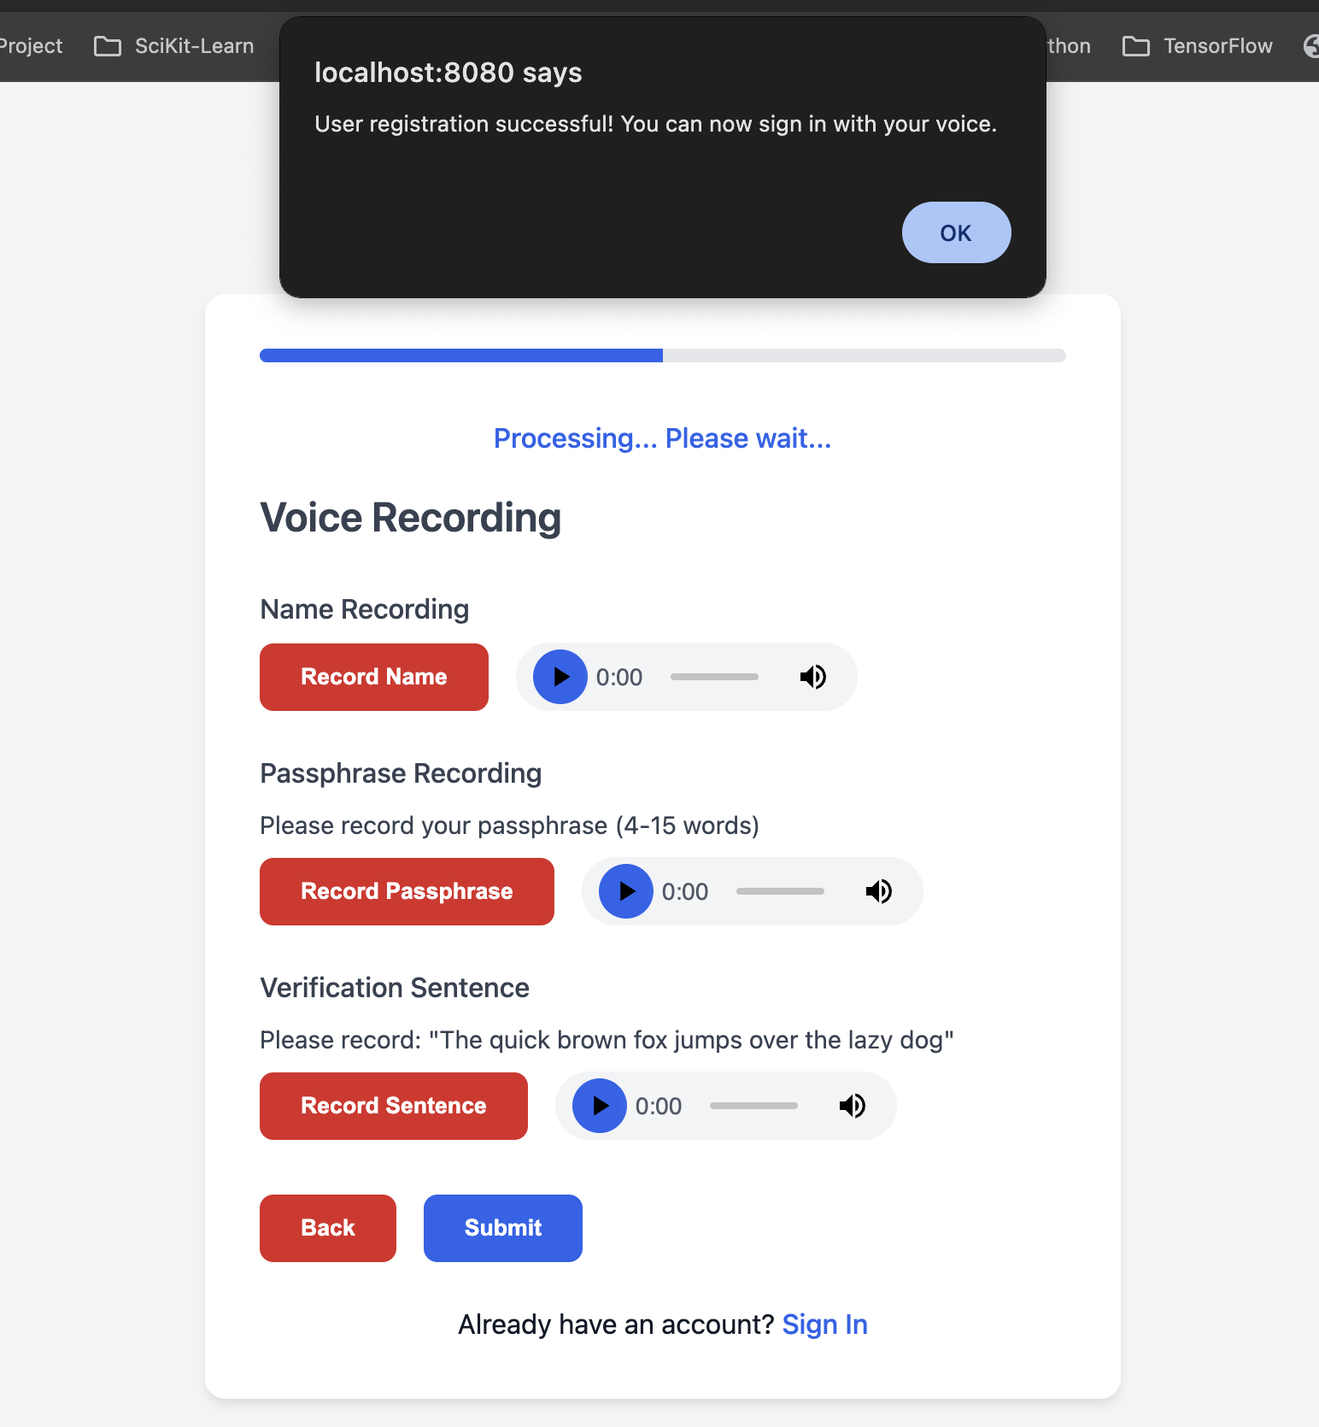
Frontend User Interface: Sign-Up Process

Slide 8
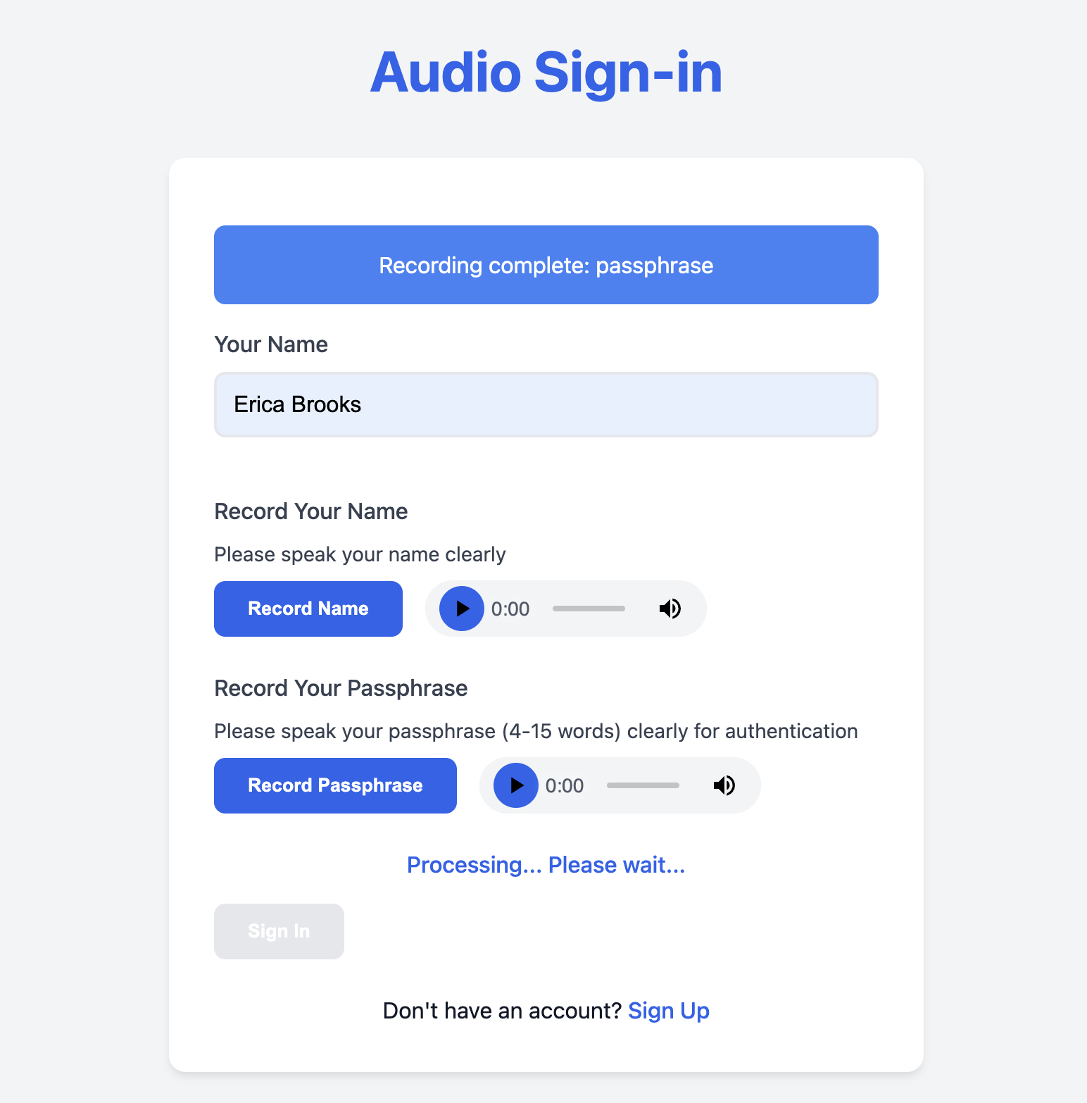
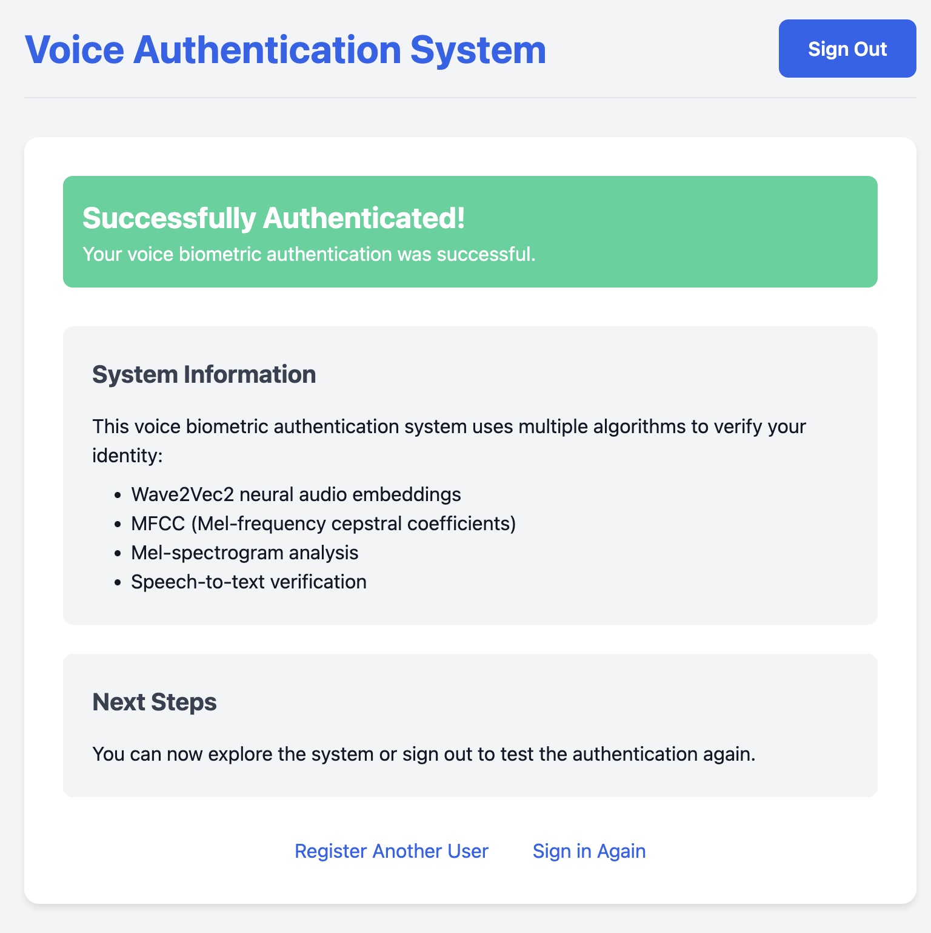
Frontend User Interface: Sign-In Process

Slide 9


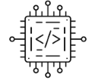
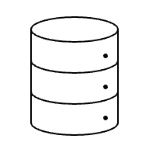

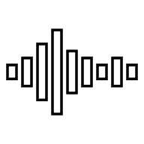


Sign-Up Process
No
User Sign up
Spoof Check
Vector DB
Yes
Vector Embeddings -
MFCC,
Mel Spectrogram,
Audio
Audio Feature
Extraction
-
MFCC,
Mel Spectrogram
Sign up Failed
Sign up Success

Slide 10

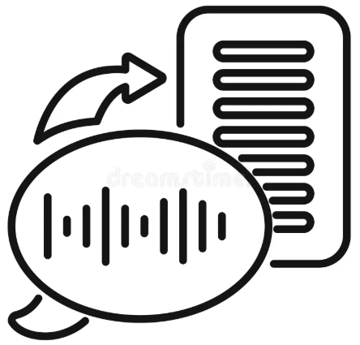

Sign-In Process
Vector DB
No
User Sign in
Spoof Check
Vector Embeddings -
MFCC,
Mel Spectrogram,
Audio
Vector Search
Yes
Yes
Audio Feature
Extraction -
MFCC,
Mel Spectrogram
Voice to Text Conversion
Name, Passphrase
Check
Sign in Success
Sign-in Failed
No
Sign in Failed

Slide 11
Results
Notes:
1min

Slide 12
AVS Spoof Results
Trained Model Results
Evaluation Model Results
Metric | Value
Best Model (Fold 4) AUC | 1.0000
Average Accuracy | 0.9981
Average Precision | 0.9996
Average Recall | 0.9983
Average AUC | 1.0000
Metric | Value
Accuracy | 0.7073
Precision | 0.9620
Recall | 0.7013
AUC | 0.8048
Notes:
1min

Slide 13
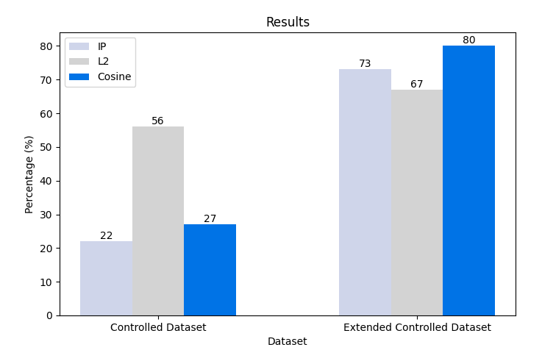
Vector Embedding Similarity Search Results
Notes:
1min

Slide 14
Overall Results
METRIC | DATASET | ACCURACY
Spoof Detection | Unseen Voice Samples | 71%
Vector Embedding | Ravdess | 55%
Notes:
1min

Slide 15
Conclusion
Notes:
1min

Slide 16




Conclusion
Stronger Encryption
Improve Accuracy
Improve Accessibility
Use a Diverse Dataset
Notes:
1min

Slide 17
Come See A Live Demo!!!!

Slide 18
Questions

Slide 19
Appendix
Notes:
If we get specific questions on these areas, we will have images ready to talk too…

Slide 20
Audio Biases
Dataset | CONS
Voxceleb | Video Files, No Audio Samples
Ravdess | Short Audio Samples
AVS Spoof | Large Dataset, Hard to manage

Slide 21


AVS TensorFlow Spoof Detection Model
5 Kfold
128n
Input: 200n
∑
Best Results
sig
64n

Slide 22
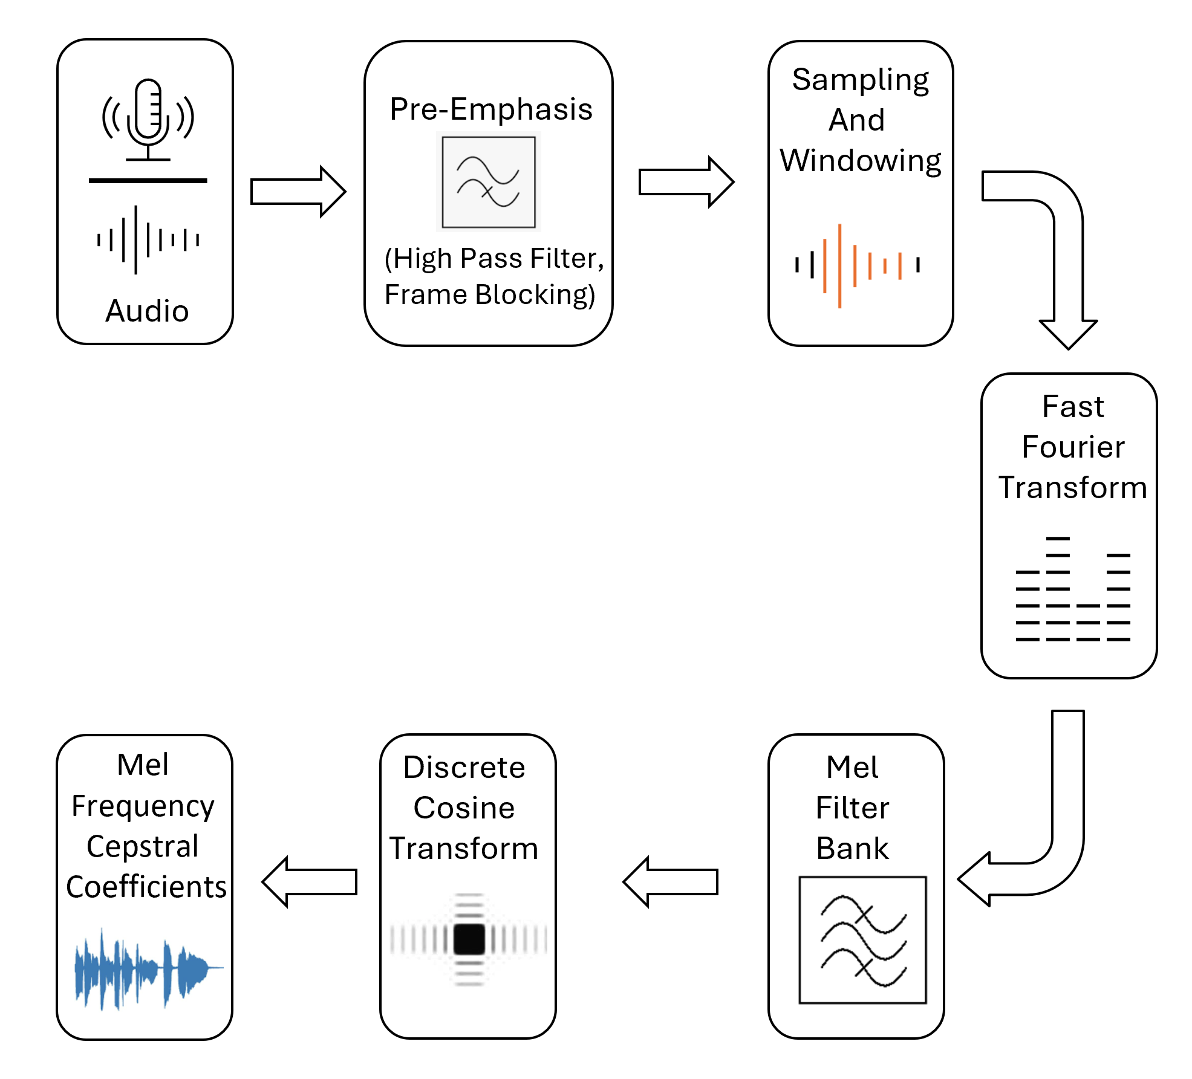
Mel-Frequency Cepstral Coefficient (MFCC)

Slide 23
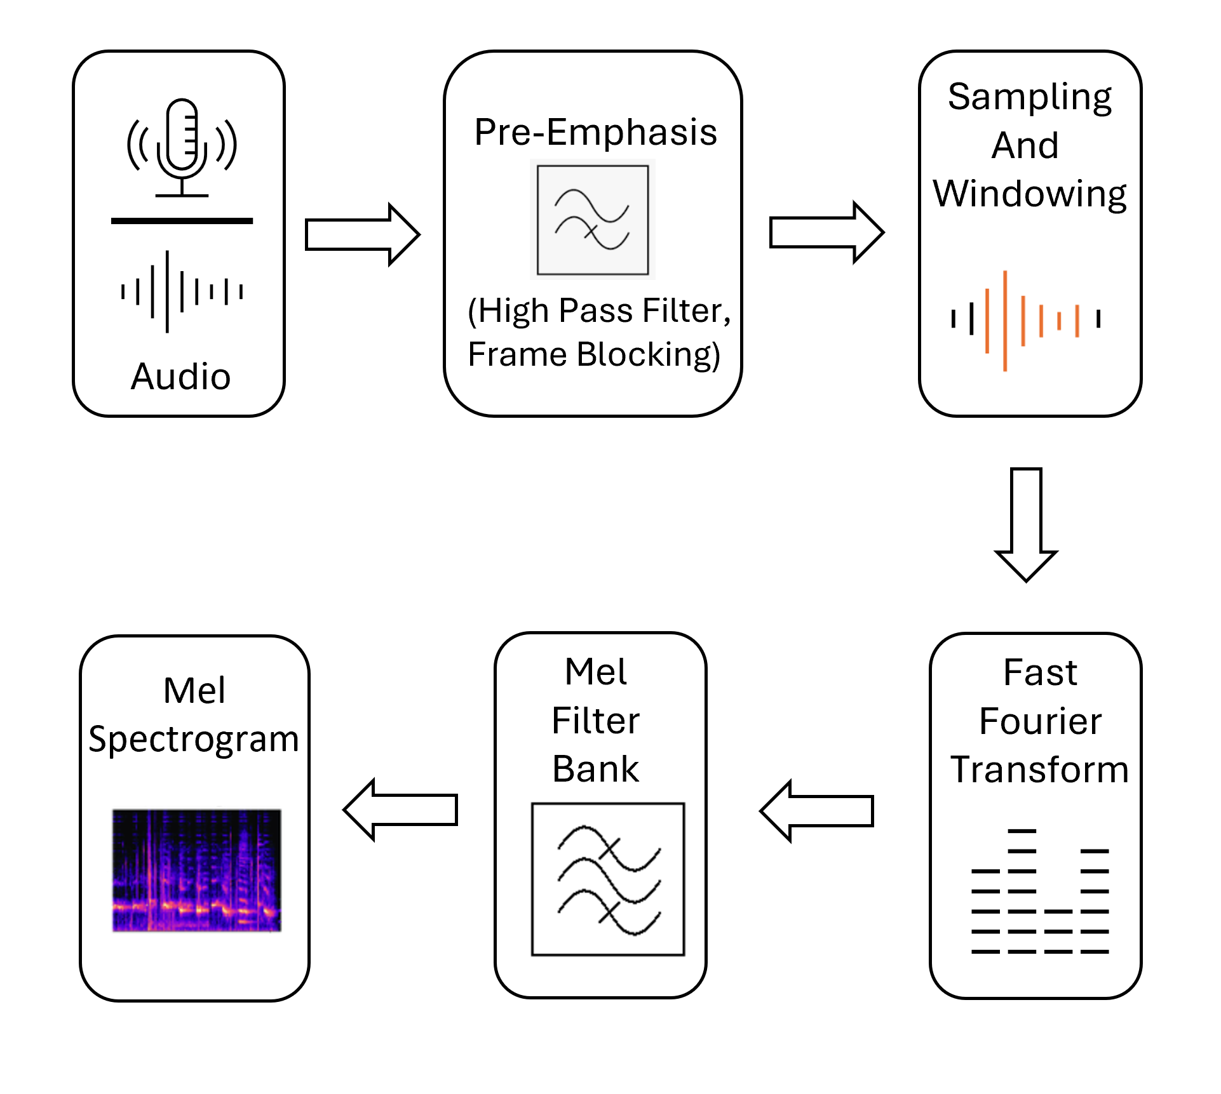
Mel-Frequency Spectral Coefficients (MFSC)

Slide 24
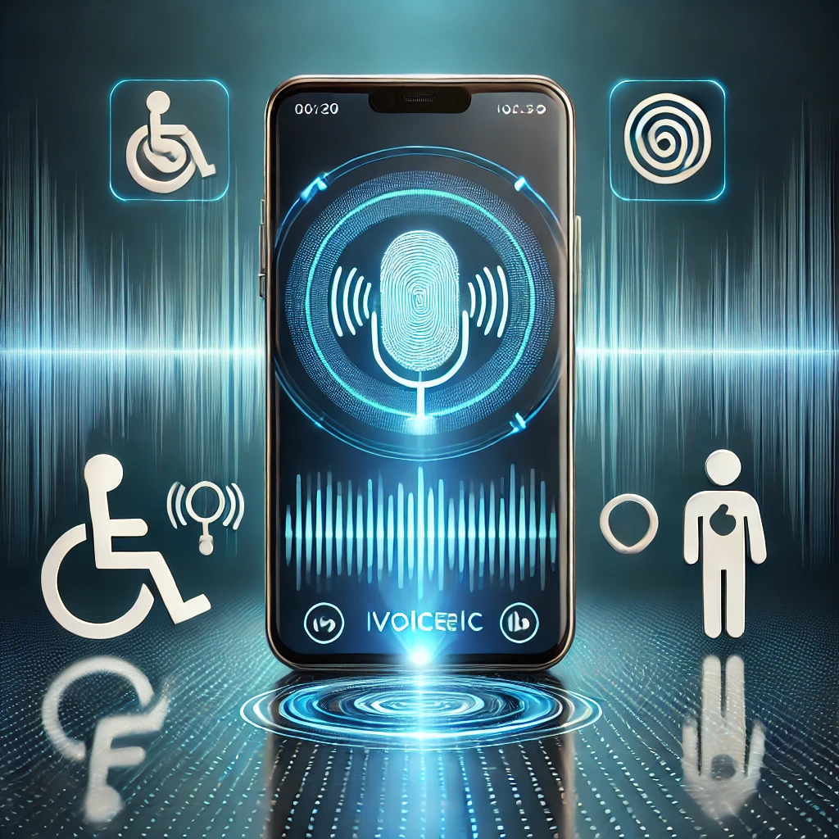
Group Members
•Brooks, Erica - ericab@mail.smu.edu
•Jacob, Lijo - lijoj@mail.smu.edu
•Lewis, Lani - lanil@mail.smu.edu

Slide 25
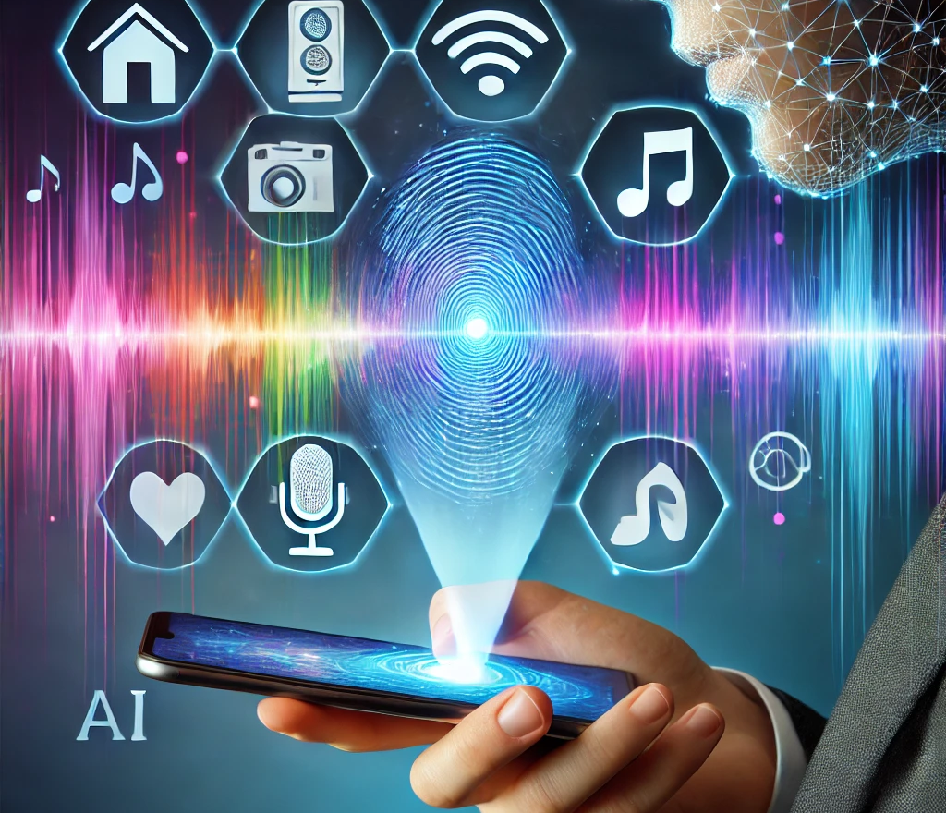
Advisors
•Negi, Shivam - Industry veteran overseeing GenAI teams at Walmart.
•Mittal, Gaurav - Expert in the security and vulnerability management teams at Zoom Video Communications.
•Javed, Faizan – NLP Professor, and Sr. Dir - Chief Data Science at Kaiser Permanent

